Slide 1
Real-world Perspectives on the Interplay Between Standards and Research
Dave Lewis, Trinity College Dublin
Harsh Pandit, Dublin City University
ADAPT Centre

Slide 2










ADAPT Centre
AI Driven Digital Content Technology Research
Human-Centric AI
A Single Virtual Research Centre Across 8 Universities
Collaborating since 2007, in current form since 2015
Third funded by Science Foundation Ireland €6M pa, rest industry + EU
Currently 81 Faculty + 53 collaborators
  > 215 Researchers
  ~50% non-ICT
2
Notes:
ADAPT is an ambitious research centre, and seeks to enhance is scientific excellence and increase its research impact.
A key part of the strategy to achieve this is to
- strategically add new and deepen existing scientific expertise (both in the core areas of AI driven digital content technology as well as in multi-disciplinary areas (e.g. ICT, Healthcare, Business, ethics to name but a few)
- increasing the research capacity of the Centre by increasing its talent pool
- Support the sustainability of the centre by Growing its the geographic based withiin Ireland
In order to tackle such growth plan, ADAPT envisages increasing its number of Principle Investigators to 22
and the number of Funded Investigators to 52
Such sustainable growth was possible by increasing the number of academic partners to EIGHT and to
Expand its geographic base within Ireland
ADAPT Strategic Goals and Strategy
Research Competitiveness and Quality Improvement
Research Capacity
Industry Engagement
Non-exchequer Research Funding Diversification
Operations and Support Improvement
Education and Public Engagement

Slide 3













Experiences: Localisation Industry and Multilingual Web – Harmonisation & Implementation
Standards Development and Harmonisation
  Oct’13: ITS2.0 Ratified by W3C
  Aug’14: XLIFF 2.0 Ratified by OASIS
  XLIFF2.0-ITS2.0 mapping as XLIFF2.1 Oct’15
  FEISGILTT workshop series
  Localisation Focus special standards issues 2013, 2015
  Communication to practitioners:
    Multilingual Magazine – Annual Standards Reader
    Lewis et al, Translation Spaces Journal 2014
Linked Data Interoperability in Localisation
  Open Data in commercial SME tool chain
  XLIFF, TBX, TMX to linked data mappings
  Contributing to surveys, use cases and best practice for Linguistic Linked Data

Slide 4


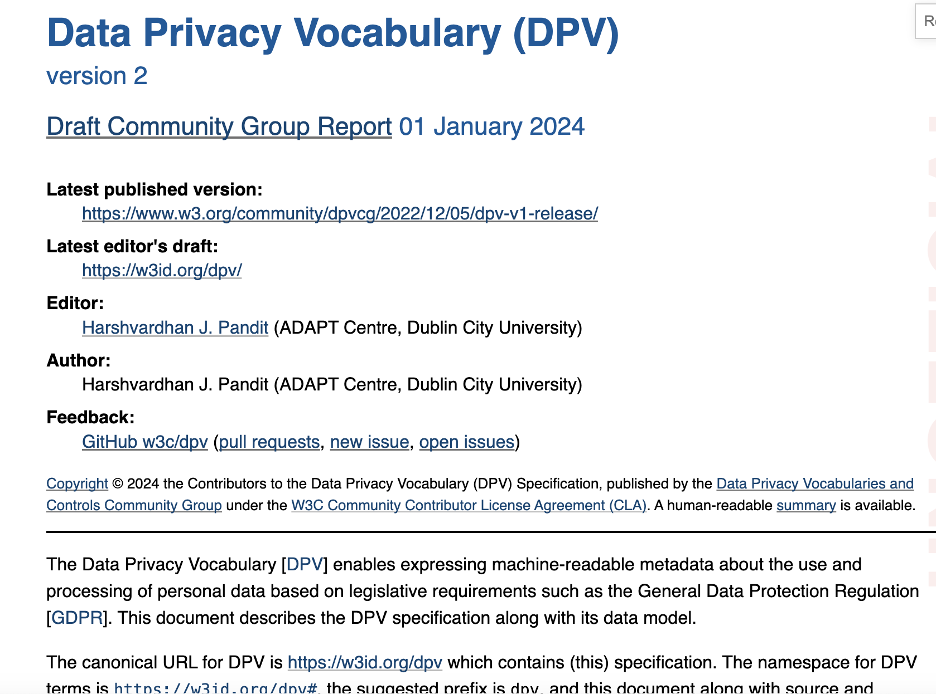
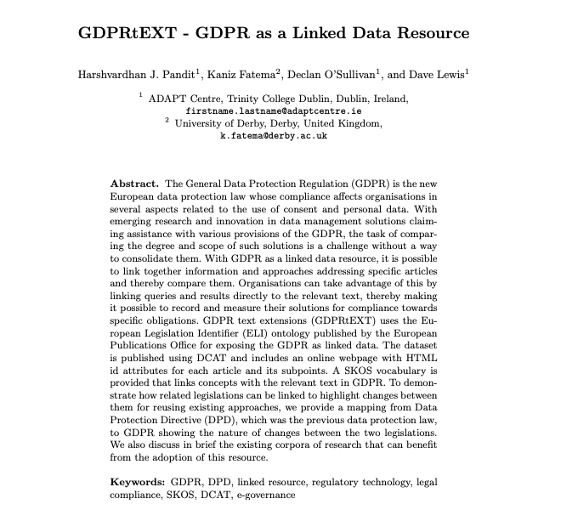



Experiences: Open Legal Compliance Vocabularies – Community driven, EU aligned
Input
Output
Outcomes
Impact
Open data for GDPR compliance
Open provenance, queries, constraints
Semantic GDPR models - Legal Text, Consent & Provenance
Series of Publications
W3C Data Privacy Vocab
EU Legal Data prize
EU Pub Office Engagement
IE and EU funding
International leadership – open data privacy vocabulary
Industrial DPV adoption
Consent Receipt ISO/IEC TS 27560
https://w3id.org/dpv/
Protect ITN
Notes:
One or more slides presenting the scientific excellence of the theme as suits the theme (e.g., paper screen captures, or 'Scientific Impact'), part of the point of this is to point to the posters

Slide 5







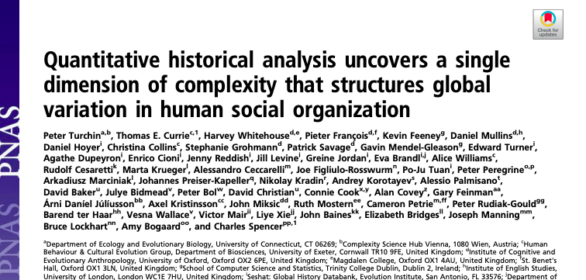








Experiences: Public Sector Open Data Integration – Multidisciplinary resources
Input
Output
Outcomes
Impact
Semantic Uplift for Relational DB and Building Information Models
High Impact journal publications
Long term engagement with OSi
Novel Governance and Quality of Mappings
Geospatial Data Uplift at Scale
Improved data mapping standard and product
Integrated building and geospatial data
New medical and historical/cultural dataset
Public Open Data capacity building - 40+ trained
Helped IE rank top in EU open data maturity
Improved DBpedia link quality
24.8M invested in Data Chemist Spinout
5
5
Notes:
One or more slides presenting the scientific excellence of the theme as suits the theme (e.g., paper screen captures, or 'Scientific Impact'), part of the point of this is to point to the posters

Slide 6







Track Record: Standards Capacity and Skills Building
ELITE-S - https://elite-fellowship.eu/
  10 MSCA Postdoctoral Fellow specializing in research with ICT standards
StandICT - https://standict.eu/
  Reports and Cascading funding for expert participation in standards
HSBooster - https://www.hsbooster.eu/
  Standards experts and training for EU projects
ADRA-e - https://adra-e.eu
  Landscape report and resource centre for ADRA
EDU4Standards.eu – https://www.edu4standards.eu
  Standards education resources, courses and promotion, teacher and student networks

Slide 7
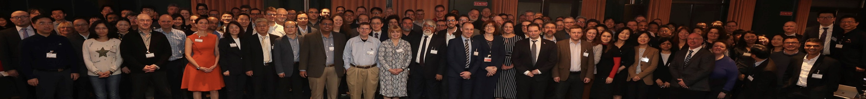

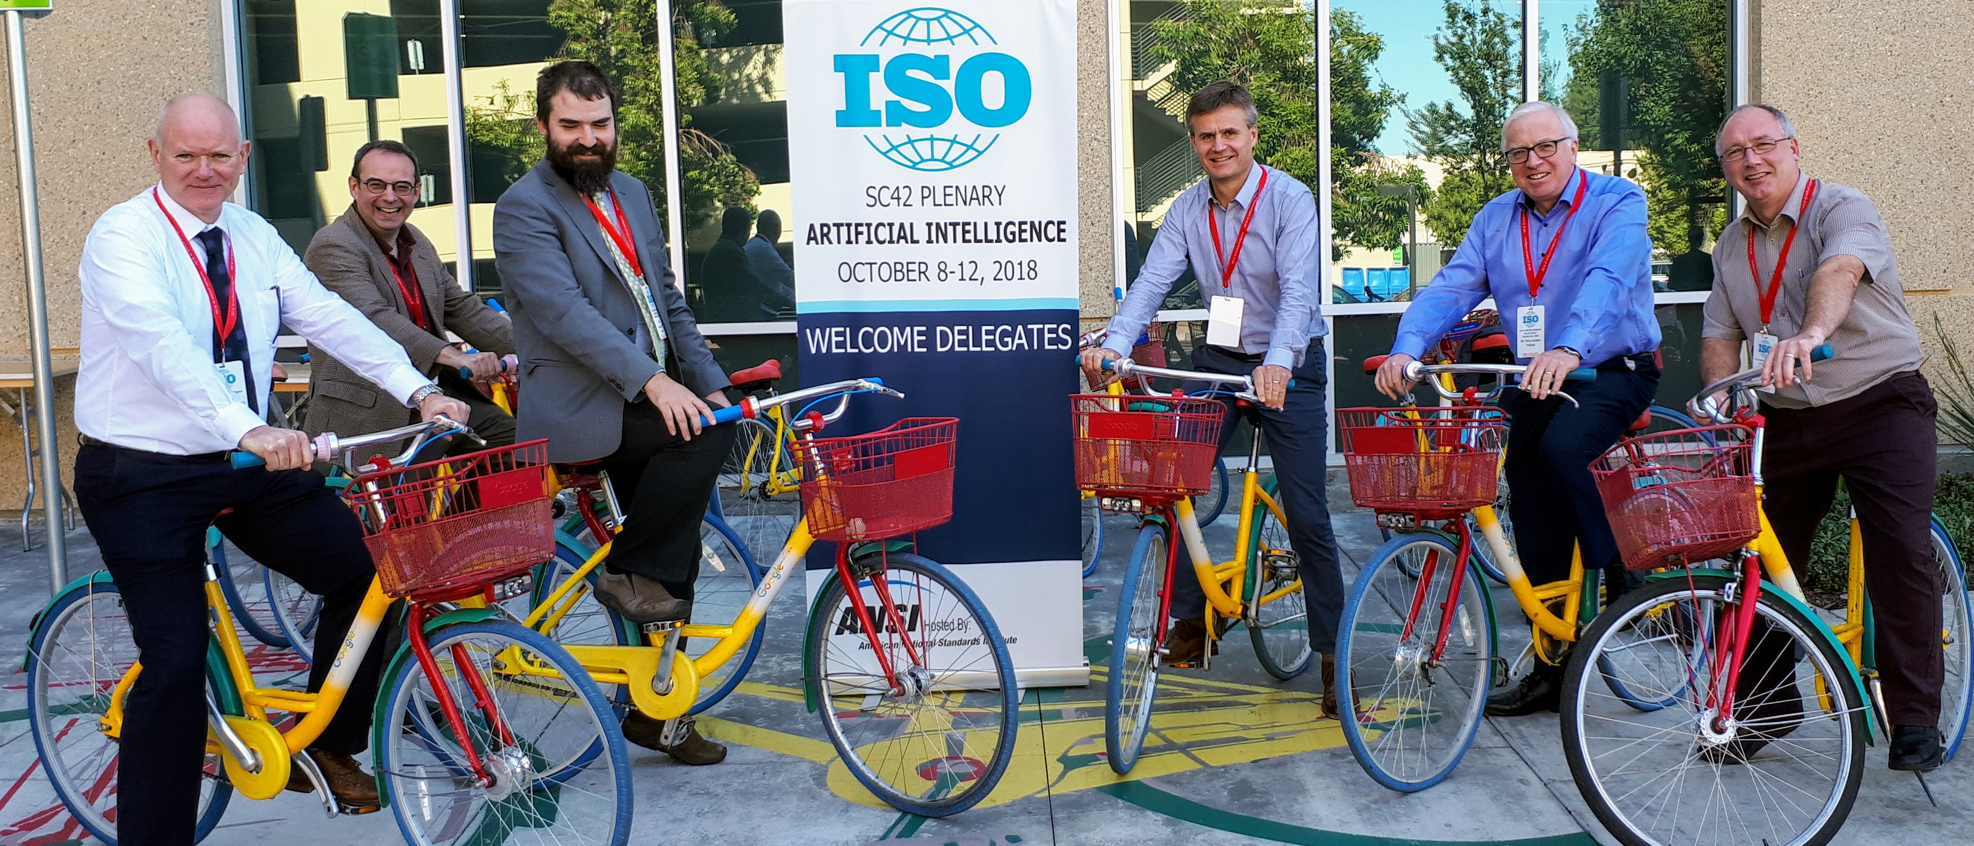
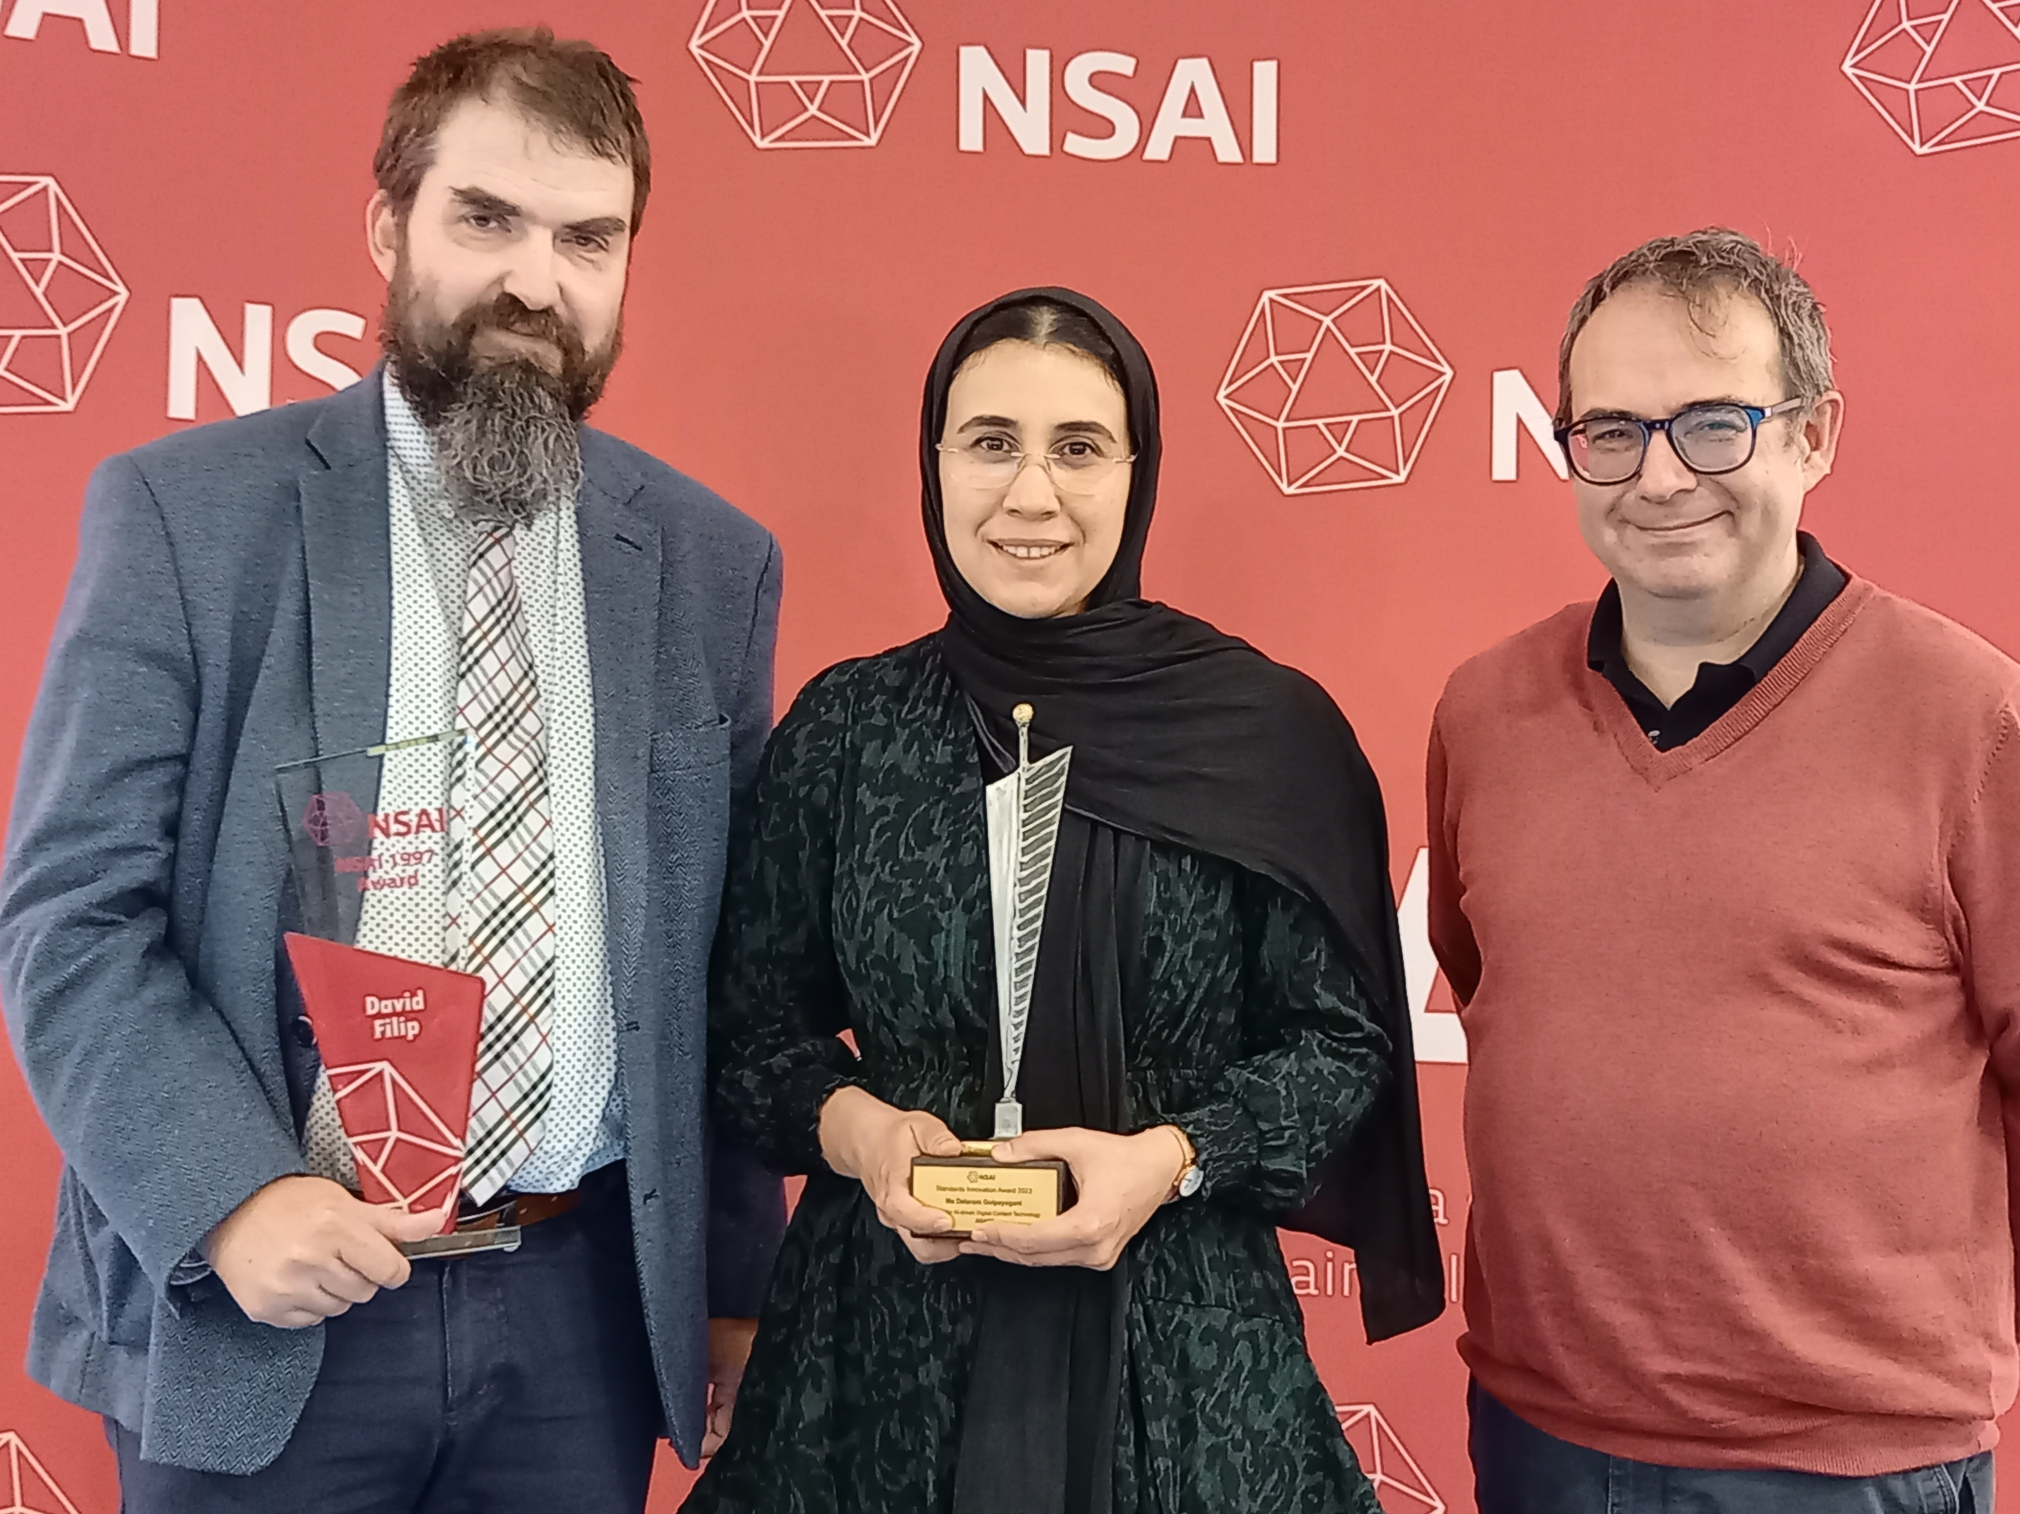
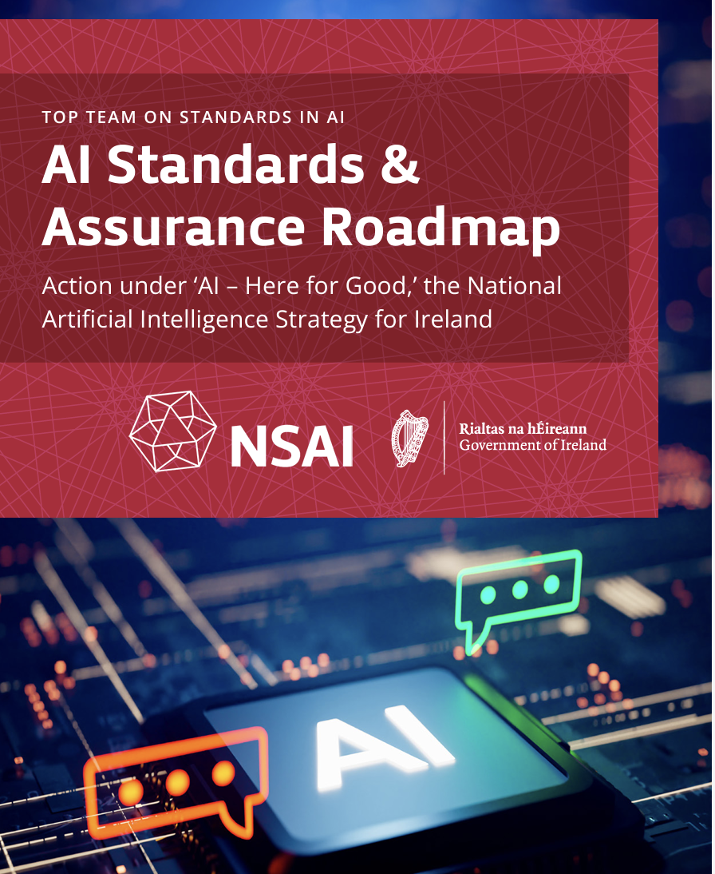
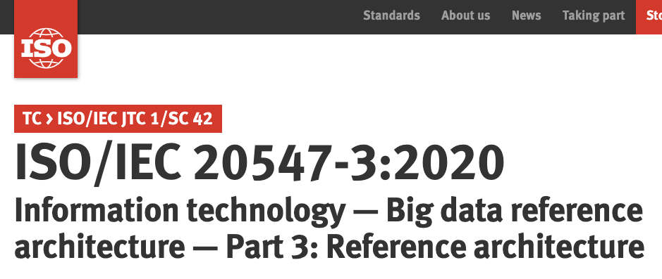
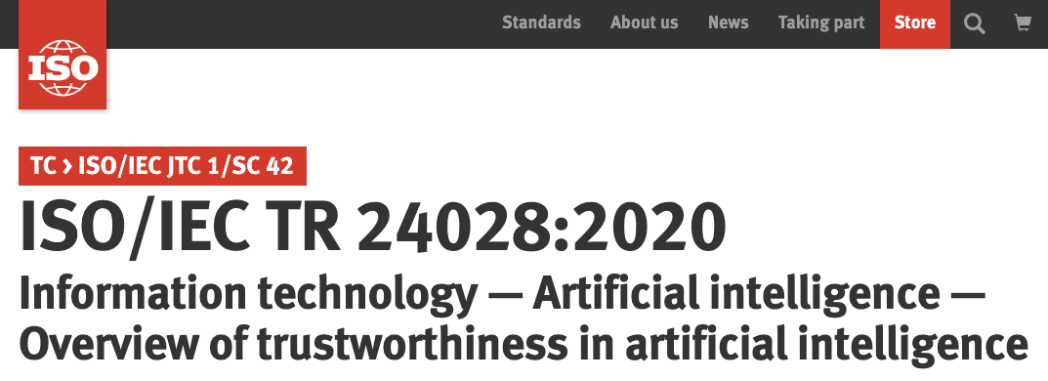
Track Record:
AI Standardisation
ISO/IEC SC42 and CEN/CENELEC JTC21
National Standards Authority of Ireland - AI Standards and Assurance Roadmap
ADAPT Research on Open Resources and Tools

Slide 8
Standardisation and Interoperability Challenges for the AI Act
Complex info exchange between AI Providers/Deployers & regulators
Value Chain Transitivity of Quality/Risk Assessments and incident reports
Public Interest comparisons of FRIA/incidents/risks assessment
Oversight Authorities:
existing product regulation + new biometric identification
existing product regulation + new high-risk areas
27 member states
Conformity Assessment Bodies
Health, safety + 54 fundamental rights
Market Surveillance Authorities
Conformity Assessment Bodies
Market Surveillance Authorities
Conformity Assessment Bodies
Market Surveillance Authorities
CE Mark
Audits and Incident Reports
Risk Assessment
AI Provider
Operation
FRIA
Support
Performance Evaluation
AIA Compliant Quality Management System
42001
AI Deployer
Data/Model Suppliers
Planning
Data/Model importers (US/UK/CN etc)
Leadership
Improvement
Mapping from certification from other Jurisdictions
Context
Affected Stakeholders:
EU residents impacted by AI high risk areas

Slide 9
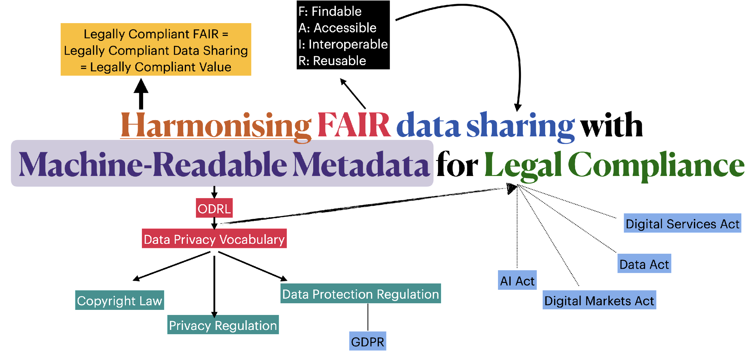
Creating “Scalable Compliance” upon Machine Readable Metadata

Slide 10

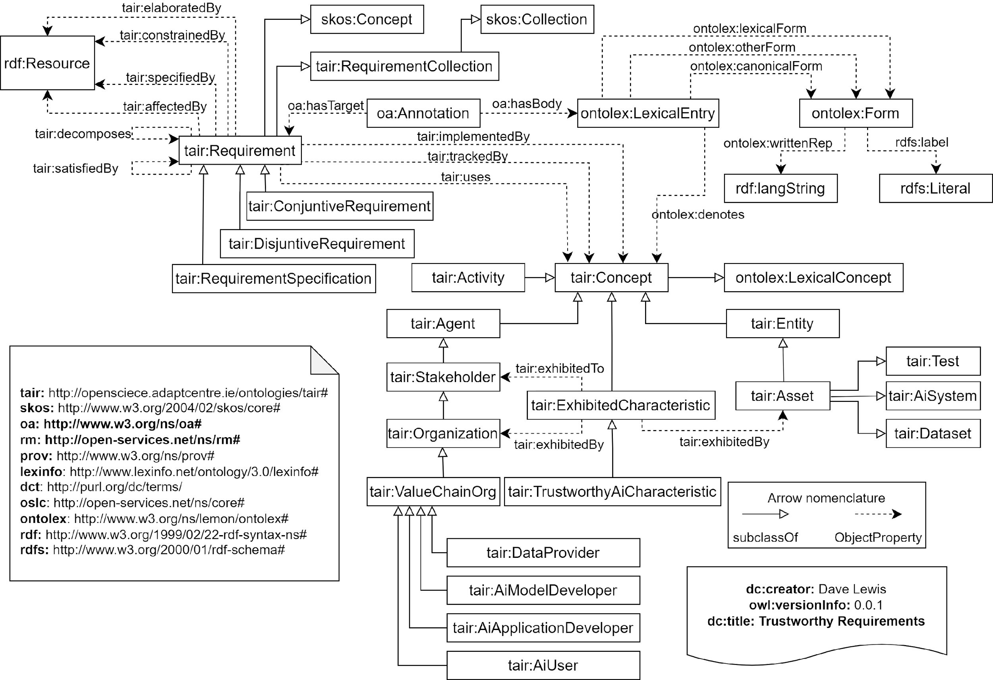
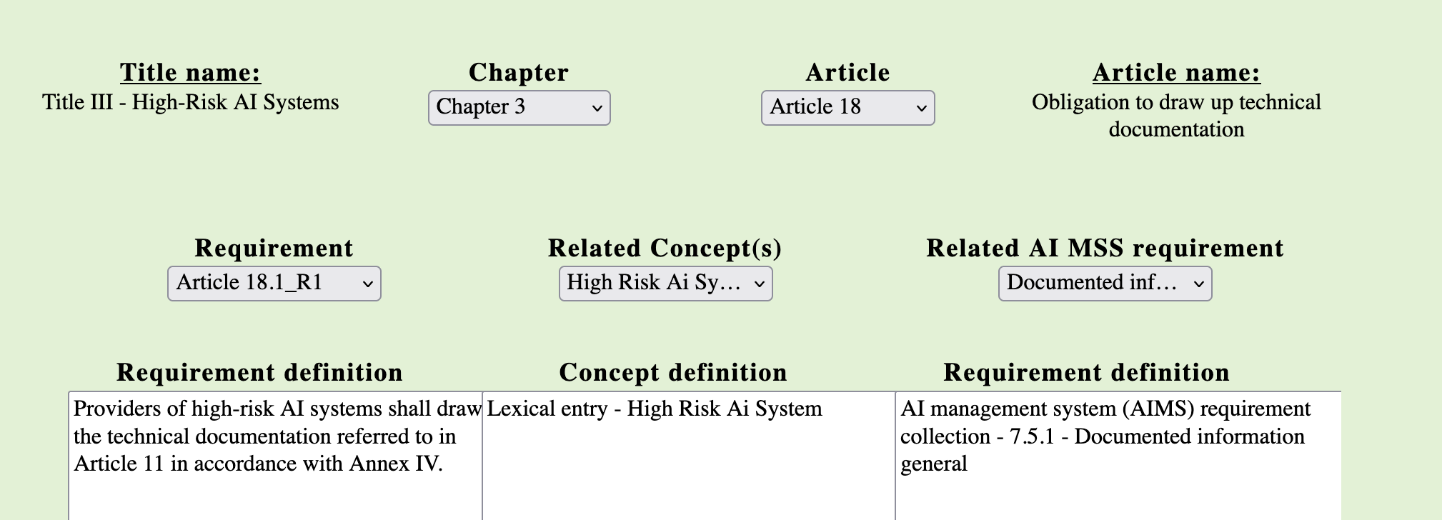
Mapping AI Act Requirements to AIMS Requirements
TAIR demo: The demo explores the Title III of the Draft AI Act mapped to High-Risk AI System requirements (ISO 42001)
  https://tair.adaptcentre.ie
This project has received funding as a research gift from Meta and is supported by the Science Foundation Ireland under Grant Agreement No 13/RC/2106_P2 at the ADAPT SFI Research Centre and the European Union’s Horizon 2020 Marie Skłodowska-Curie grant agreement No 813497 for the PROTECT ITN.

Slide 11
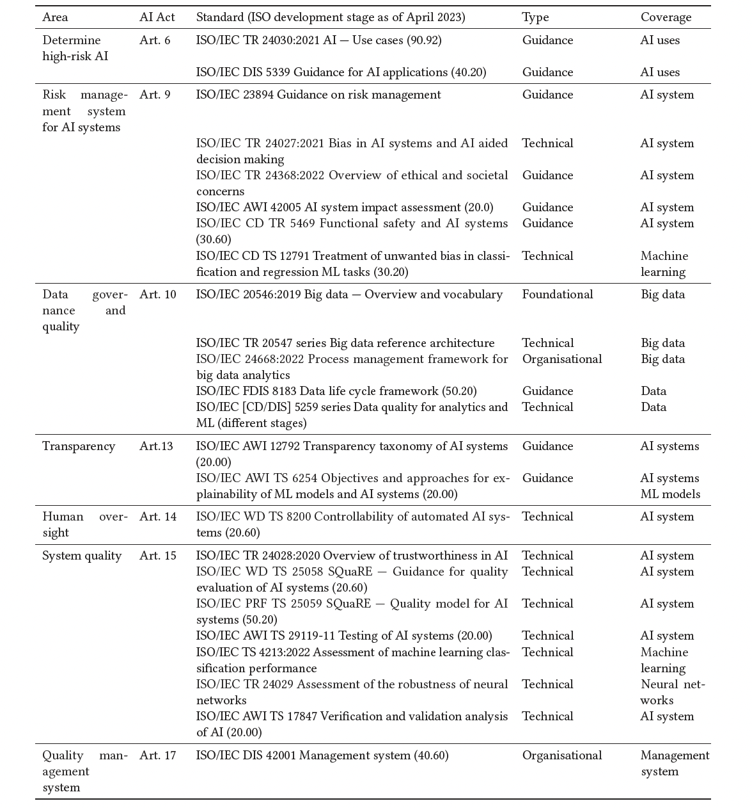
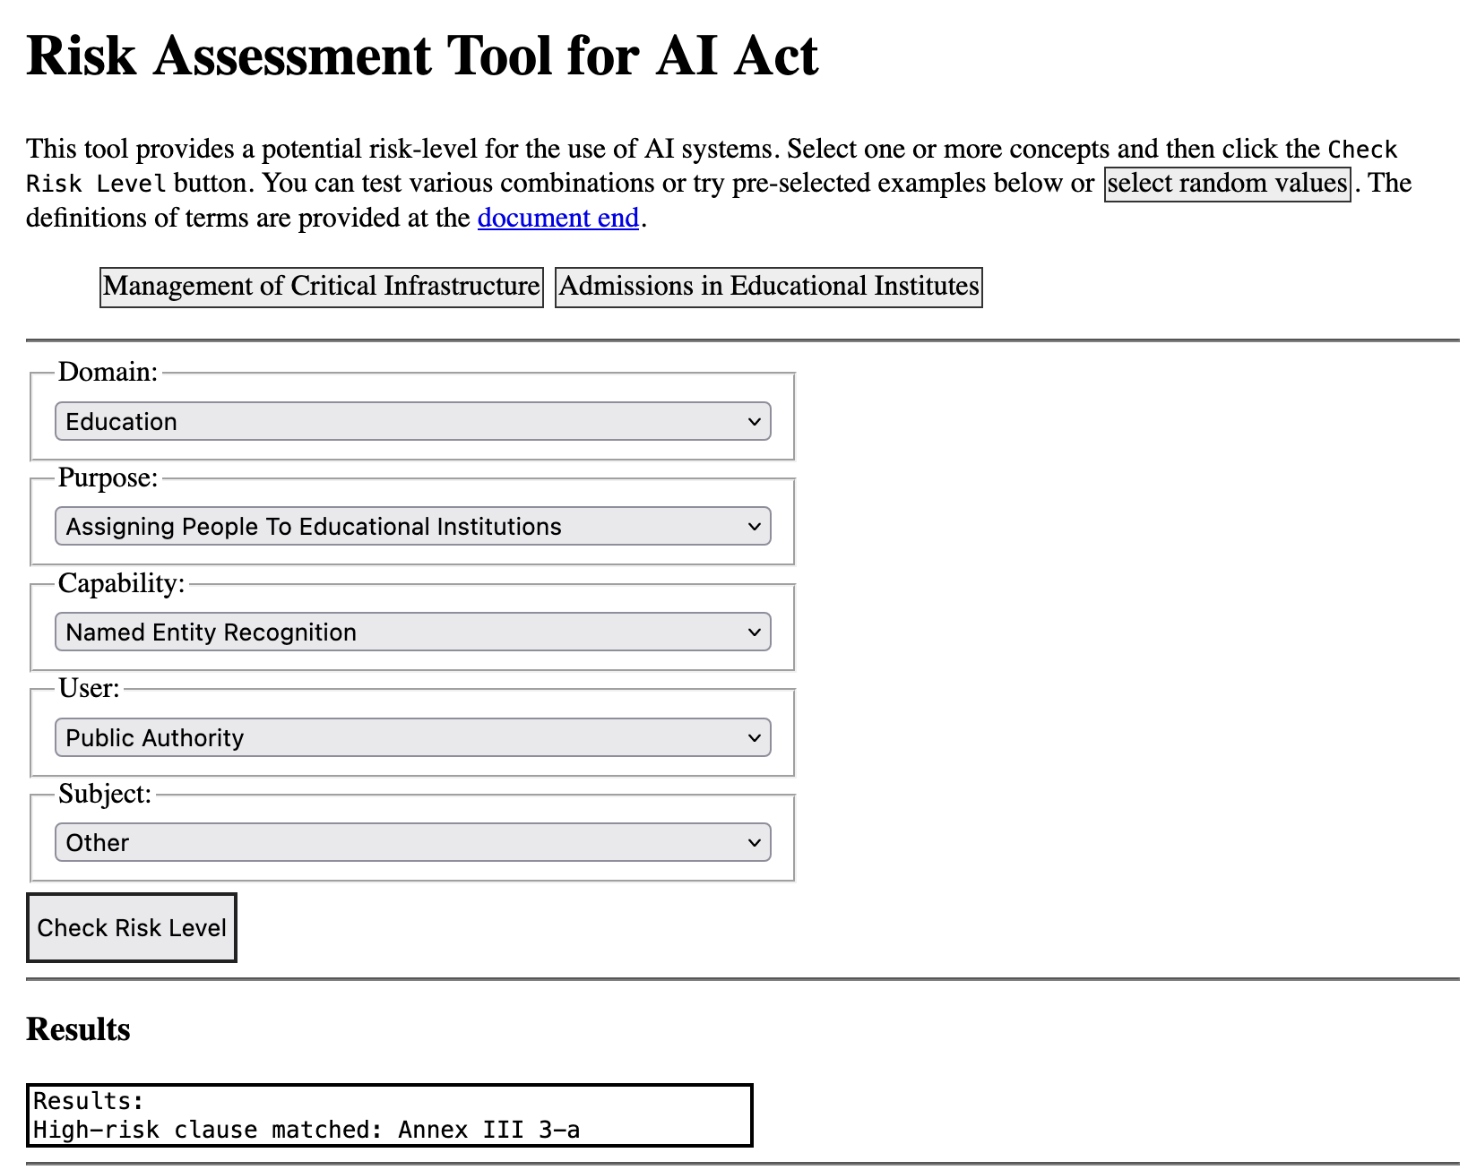
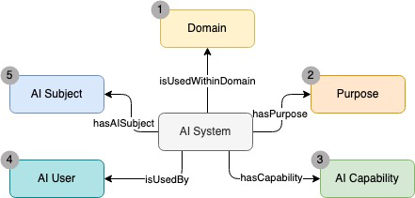
Open Vocabulary and Tools for AI Risks
  The AI Act
  ISO/IEC 22989 AI concepts and terminology and ISO/IEC 23894 AI Risk
  AI Watch’s taxonomy
AI
Techniques (19)
Capabilities (30)
Types of AI (17)
Components (34)
Characteristics (20)
Outputs (6)
Risk
Risk Sources (43)
Consequences (4)
Impacts(12)
Impact areas (5)
Controls (18)
Document and standard
Documents (12)
Standard (22)
Uses of AI
Purposes (114)
Domains (13)
Stakeholder
Stakeholder roles (40)
  https://regtech.adaptcentre.ie

Slide 12
Research & Standardisation: Pain Points
Research lifecycle vs. Standards lifecycle
Knowledge creation, evaluation & citation vs. Consensus building
Reliance on enthusiasts vs. building Capacity and Skills
Open access research vs. Pay-to-read, Pay-to-play
Suggestions for Implementing Code of Practice….

Slide 13
Standards Code of Practice: HEI and RPOs
2.1 It is recommended to develop a standardisation policy, self-standing or as part of an intellectual property or research results valorisation policy.
  Develop Policy at State Level with NB and local RFO
2.2 It is recommended to consider standardisation activities and outputs appropriately in the career development plans and research assessment exercises of researchers.
  Recognition and Parity of esteem – e.g. chairing WG equivalent to chairing conference?
  Smooth on- and off-ramps for researchers
  Bibliometrics for standards
2.3 It is recommended to provide for education and training on standardization
  Good Progress from HSBooster, now EDU4Standards – national level reuse
2.4 It is recommended to make Technology Transfer Offices fit for standardisation
  Align to open access policy and lower paywalls for researchers
  Manage divergence and independence of outputs from research and SDO consensus
2.5 It is recommended to develop an indicator and evaluation system.
  Common descriptions for engagement levels - e.g. profile in the Researcher Development Framework

Slide 14
Standards Code of Practice: Project Partners - 1
3.1 It is recommended to analyse the existing standards landscape and assess the contribution which standardisation can offer to the research and innovation project.
  And vice versa, but paywalls impede this at project inception stage for new entrants
3.2 In case of a collaborative project, it is recommended to create in the consortium a common understanding as well as a common strategic position on standardisation and standardisation issues.
  TTO and industry buy-in and IP template for consortium agreement clauses
  Multi-year perspective on rolling plan
3.3 In case of a collaborative project, it is recommended to involve partners with standardisation experience in the team, with good access to the standardisation community
  How to sustain brokerage after HSBooster? Public Registry? Role for NBs?
3.4 It is recommended to make standards a tangible component of the project
  Needs to accommodate timing/progress uncertainties
  Test suites, implementation guidelines and compliance tools are more tangible outputs
3.5 It is recommended to invest in and cater for stakeholder engagement throughout the project.
  SDO struggle to engage non-implementing affected stakeholders – strong potential via engaged research in research projects
  Early development of conformance test-suites as an engagement instrument

Slide 15
Standards Code of Practice: Project Partners - 2
3.6 It is recommended to be realistic about outputs, outcomes and impact and to consider suitable key performance indicators.
  Align to time windows and effort available, e.g. W3C community groups and International Workshop Agreements
  Low risk mechanisms for revising project workplan
3.7 It is recommended to strive for combined qualitative and quantitative performance reporting for evaluations and monitoring.
  Monitoring bound to workplan can erode ambition given external risks of SDO consensus processes
3.8 It is recommended to take standardisation considerations into account in innovation and intellectual assets management (and vice versa).
  Major issues remain around open access expectations in standards vs research
3.9 It is recommended to ensure sustainability beyond the running time of the project.
  Bridges to MS and EC supports
3.10 It is recommended to address standardisation within sector platforms, Public and Private Partnerships, project clusters, R&I Centres or other joint fora.
  Needs networks for experience and expertise exchange and avoidance of duplication, promotion to sectoral industry/professional bodies

Slide 16
Standards Code of Practice: Policy & Stakeholders
4.1 It is recommended to promote standardisation as means of knowledge valorisation at national and regional level through collaboration with SDOs, higher education institutions as well as associations of R&I organisations and Technology Transfer Offices.
  Need repeatable patterns for a NBs to liaise with national RPOs, RFOs and industry networks
4.2 It is recommended that Member States examine the needs of startups and SMEs in R&I projects in relation to standards and standardisation.
  Timing and paywalls are also disproportionate barriers here, partnerships with HEI are key
4.3 It is recommended that SDOs further develop their service portfolios for R&I actors and examine new ways to align their activities with R&I.
  Need to include De Jure and De Facto SDO – align with PAS processes
  Training. Research license access to standards. Workshop agreements supports.
4.4 It is recommended that Member States use national support structures in relation to the role of standardisation in R&I results valorisation.
  Farm existing R&I mechanisms E.g. Enterprise Ireland Innovations Vouchers SME for Standards expert engagement – low admin, fixed price; coordinator grants
  Regular engagement between NBs and NCPs. Standing governance agenda items

