Slide 1
Standards Focusing on Research & Development
Increase the Impact of your R&I Project by Integrating Standardization
Noleen Campbell
NSAI Standards – Standards Officer
23rd April 2024

Slide 2









National Standards Authority of Ireland (NSAI)
National Standards Authority of Ireland Act 1996
Legal Metrology
National Metrology
Certification
STANDARDS
European Telecommunications Standards Institute

Slide 3

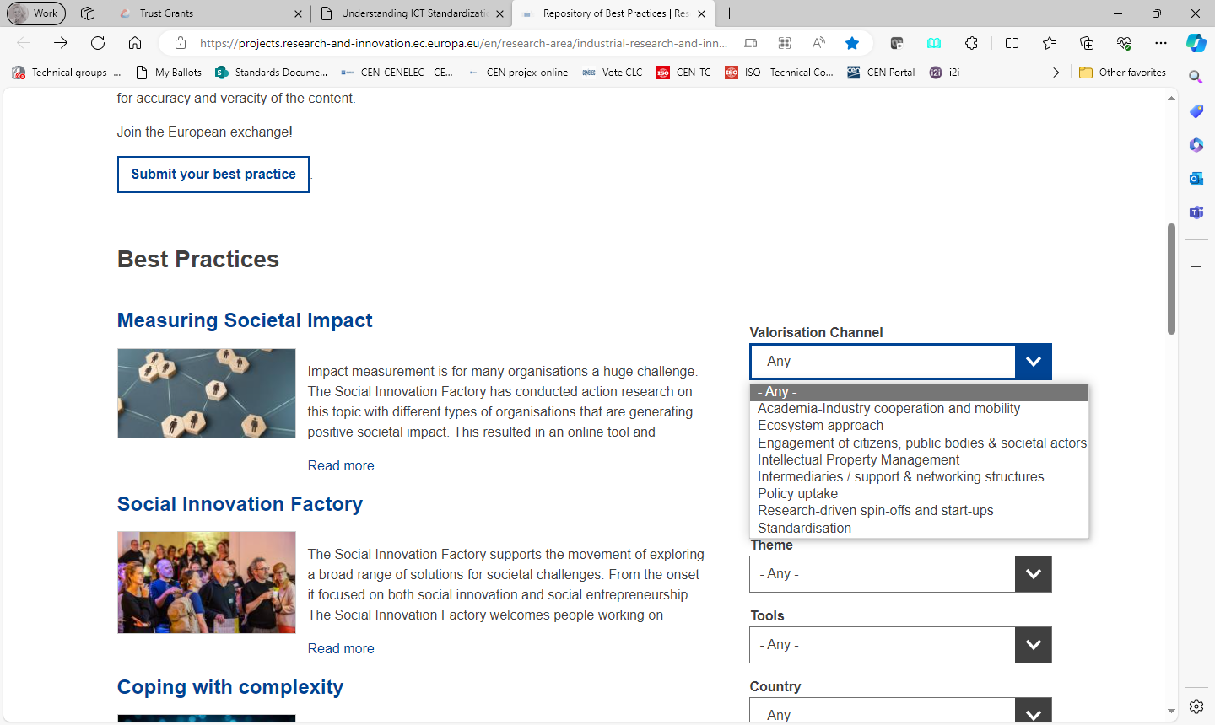

Several Technology Transfer Instruments
Source: EU Repository of Best Practices | Research and Innovation
Notes:
Ref:Repository of Best Practices | Research and Innovation (europa.eu) - https://projects.research-and-innovation.ec.europa.eu/en/research-area/industrial-research-and-innovation/eu-valorisation-policy/knowledge-valorisation-platform/repository

Slide 4

Standard Types
Fundamental
Terminology, conventions, signs, symbols
Specifications for products, services, systems, performance
Test methods and analytical methods
Organization and management system standards
make a product
manage a process
deliver a service
supply materials
    Voluntary

Slide 5
Standards across all TRLs
Mass Market
Scale
Use Cases
Reference Architecture Standards
Interoperability Standards (e.g. IoT)
Management System Standards
(e.g. new ISO Innovation Management Series)
Terminology /
Vocabulary Standards
RD&I Process (technology, product, service development)
Interface Standards
Data Format Standards
Safety Standards
Performance Standards
Materials Standards
Design Standards
Product / Service
Specific Standards
Test & Measurement
Standards
(Data Quality / Integrity)
Basic Research
Market / Technology Readiness Level (TRL)

Slide 6




Why get involved in Standards Development?
Impact at scale - Global audience
Spread technological advances, interoperability
Shorter time to market
Build networks – Transparency, Openness, Consensus, Inclusiveness
Ensure Innovations effectively solve the problems they set out to
Gain access to state-of-the-art knowledge
IP into a Standard (SEPs)
Support regulatory requirements
Opportunity for eventual public procurement
Sustainability beyond project lifetime
Standards

Slide 7

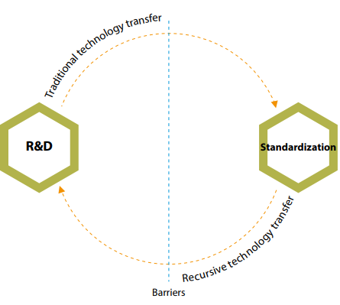

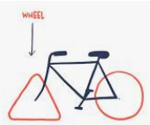
Standardization Research
Standardization and research are mutually supportive
Research produces knowledge that can flow into standards
Standards can serve as a knowledge source for further/new R&D projects
Prevents the reinvention of the wheel and stimulates ideas for new research projects
Source: ETSI - Understanding ICT Standardization
Notes:
Recursive relationship between research & innovation, and standardisation processes and how they can reinforce each other to boost knowledge valorisation
Research produces knowledge that can flow into standards – And knowledge flows from standardization back to research.
Ref: See StandICT page with list of Training and ETSI doc - Understanding ICT Standardization | StandICT.eu 2026
Figure: From ETSI doc also - Figure 5.7: Research and standardization; adapted from Blind (2009)

Slide 8
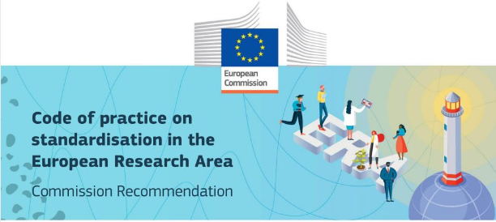
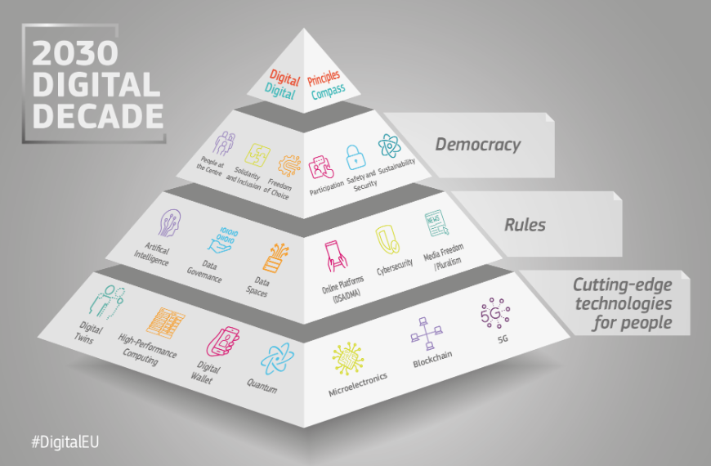



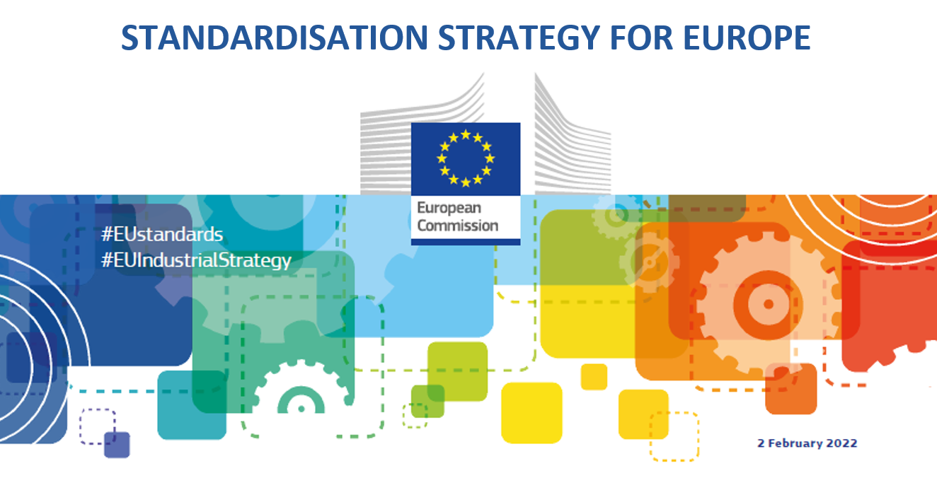
Code of Practice on Standardization for Researchers
Code of Practice on Standardization in the European Research Area
Strategic importance of standardisation
Raise Awareness among Researchers and Innovators and TTOs
“Europe’s R&I, including via Horizon Europe and its other programmes, needs to be exploited more in identifying and transferring relevant research into standards” – European Commission
Notes:
EC’s Standardisation Strategy for Europe Ref: “Europe’s R&I, including via Horizon Europe and its other programmes, needs to be exploited more in identifying and transferring relevant research into standards.”

Slide 9
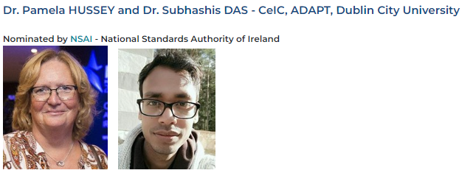
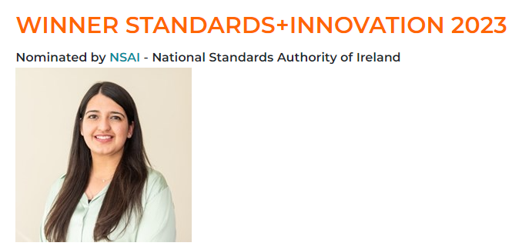


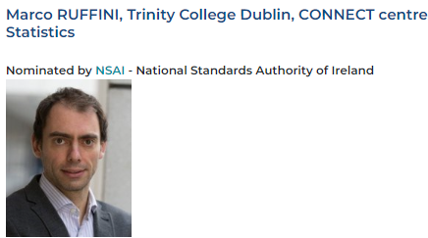


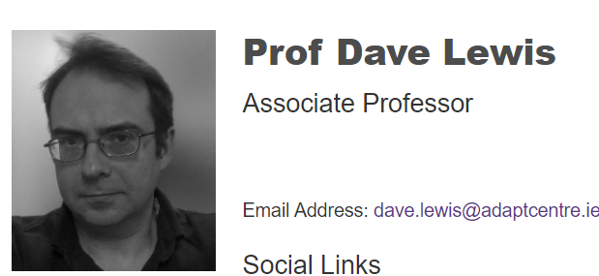


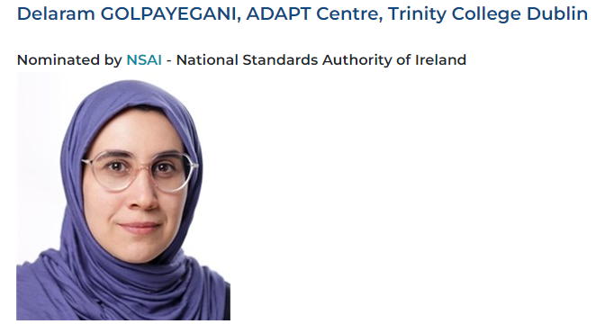








Irish RD&I Standardisation Leaders
Sweta Malik
Notes:
ADAPT Centre – Dave Lewis and nominated Delaram Golpayegani - AI
TUS – MPEG
Marco Ruffini CONNECT in the area of virtualising and slicing Passive Optical Networks
CONNECT Centre in areas such as IoT, 6G
Nominated GEOFIT Project - Deployment of novel GEOthermal systems for energy efficient building retrofitting
Nominated Pamela Hussey and Subhashis Das in the area of Electronic Health records to help with interoperability
Walton Institute – Quantum and IoT
Marei institute and UCC - Underwater Acoustics
Sweta Malik WINNER – electrical energy market trading

Slide 10

speaker.name@nsai.ie
noleen.campbell@nsai.ie

